Slide 1

Building a Chinese Car-plate Recognition System
ML Final Project
Group Members: Mengjie Shen, Yajie Xiao, Yuanhao Shen
1

Slide 2
Outline
2
Statement of the real world problem
Model Selection and Stacking
Model Implementation and Performance
Future Improvements

Slide 3
Problem Statement
Building a Chinese Car-plate Recognition System
3

Slide 4
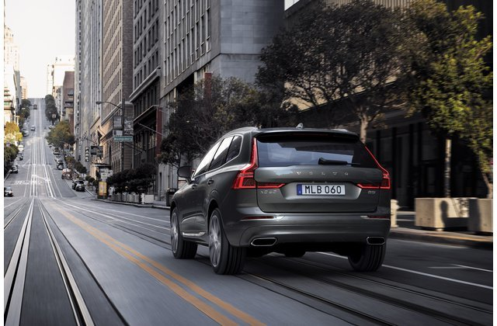
Problem Statement
4
License No: MLB 060
Given an image input containing the car plate
Detect the position of the car-plate
Extract the text on car-plate

Slide 5
Model Selection and Stacking
Building a Chinese Car-plate Recognition System
5

Slide 6
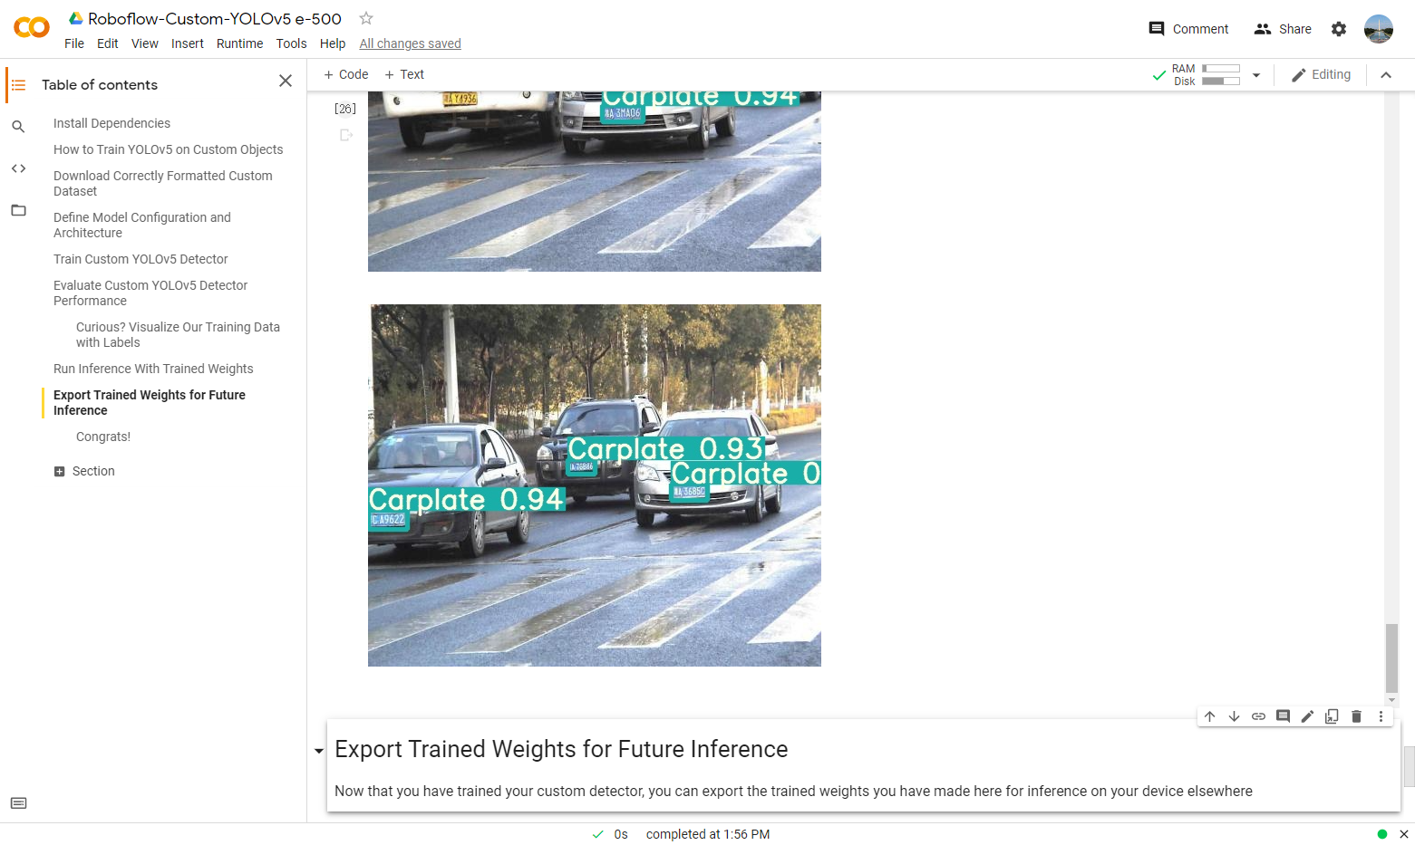
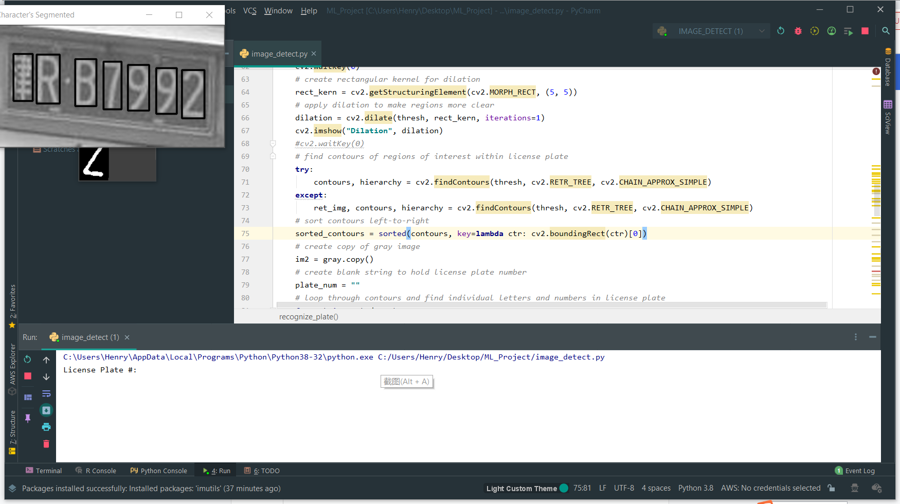
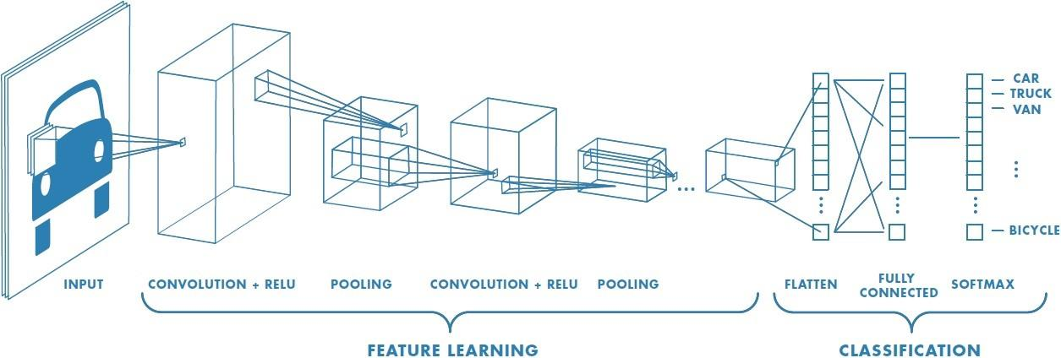




Model Selection and Stacking
Car-plate Detection
Text Recognition
Training & Evaluation
Making Inference
Using YOLO V5 and Roboflow to detect the bounding box of the car-plate
Tesseract for digits and alphabets
+ modified version of LeNet 5 CNN architecture for identifying Chinese characters
Accuracy optimization
Output the correct car plate number
6

Slide 7
Implementation & Model Performance
Building a Chinese Car-plate Recognition System
7

Slide 8
Data Preprocessing
8
Dataset: 194 pictures including the Chinese car plate from GitHub
Step1: Positioning the car plate area:
Label the pictures with the approximate area of the car plate
Roboflow to generate more images with tweaking and augmentation of the images
Feed into the yolo v5 module for training to recognize the approximate area with a confidence level

Slide 9

Data Preprocessing
9
Step 2: Identifying Edges in the Cropped Image
Convert the image to grayscale
Apply Gaussian blur to reduce noise
Python Opencv module Canny function with threshold
Find the closed rectangle with the largest area

Slide 10
Data Preprocessing
10
Step 3: Perspective Transformation
Identify and order the four points of the stretched rectangle
Push forward/ backward the image according to its relative position
Return the corrected image as the image before vectorization
Flattening the image is helpful to increase the recognition precision afterwards

Slide 11
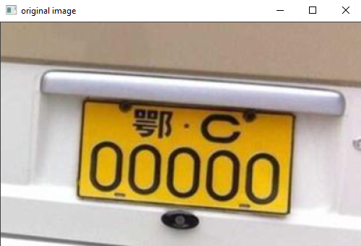
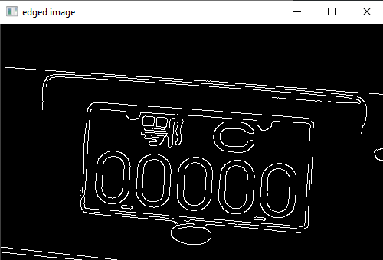
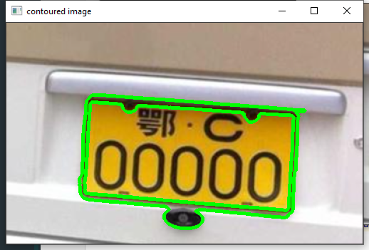
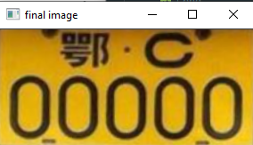
11
Step 1
Yolo v5 Cropped Image (Original image)
Opencv convert to grayscale image
Step 2
Grayscale image
Apply Gaussian blur and bilateral filter to reduce noise
Step 3
Grayscale image
Use opencv.canny to detect the edges around the picture and pick the largest rectangle
Step 4
Perspective Transformation
Image correction algorithm to flatten the image in order to increase recognition accuracy

Slide 12
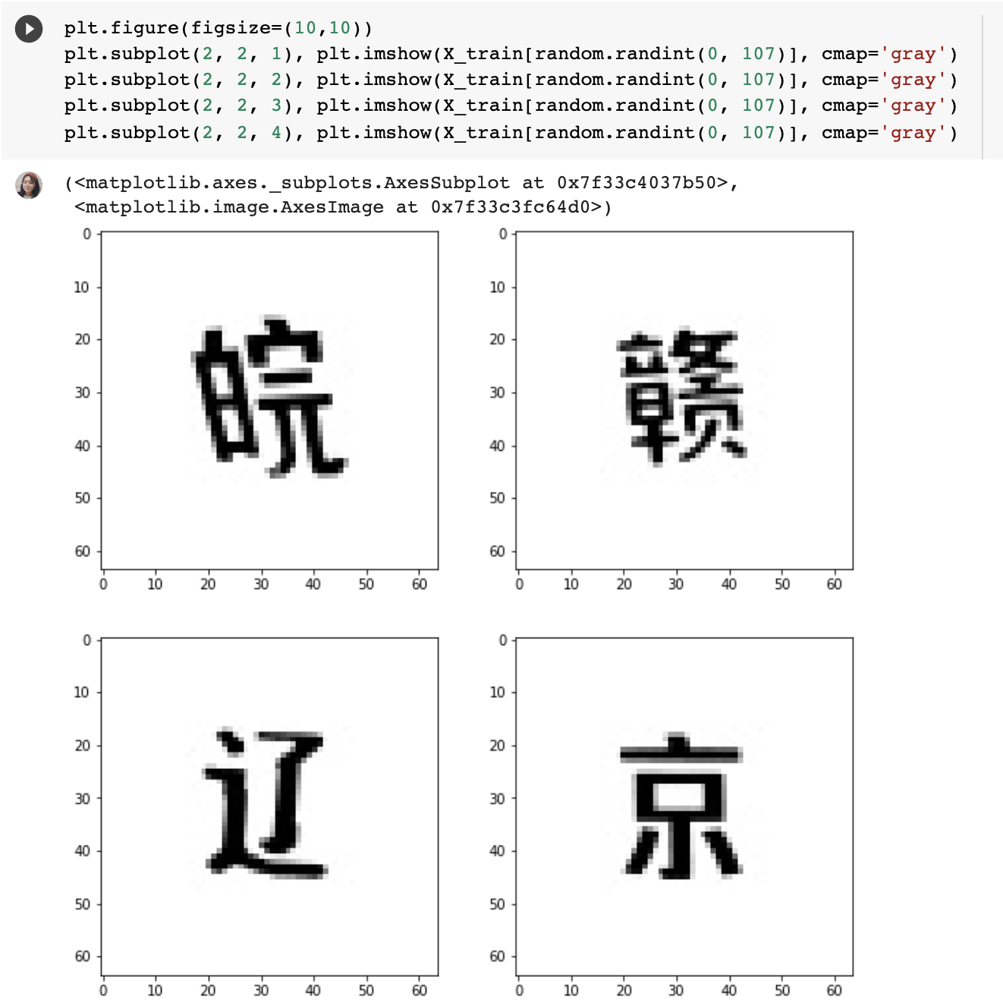
Data Visualization
12

Slide 13
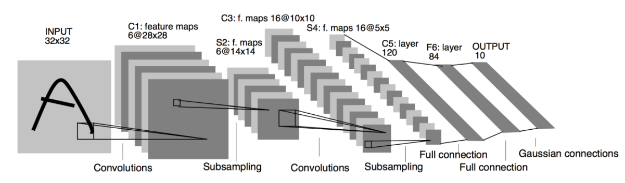
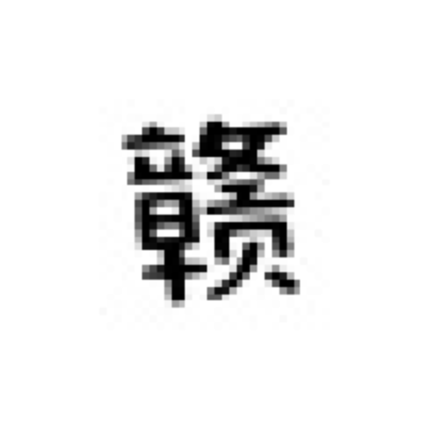
Model: LeNET
12
Inspired by the Lenet invented by Prof. Yann LeCun, we use an improved version of his network to classify the chinese province character at the first position of the car plate.

Slide 14
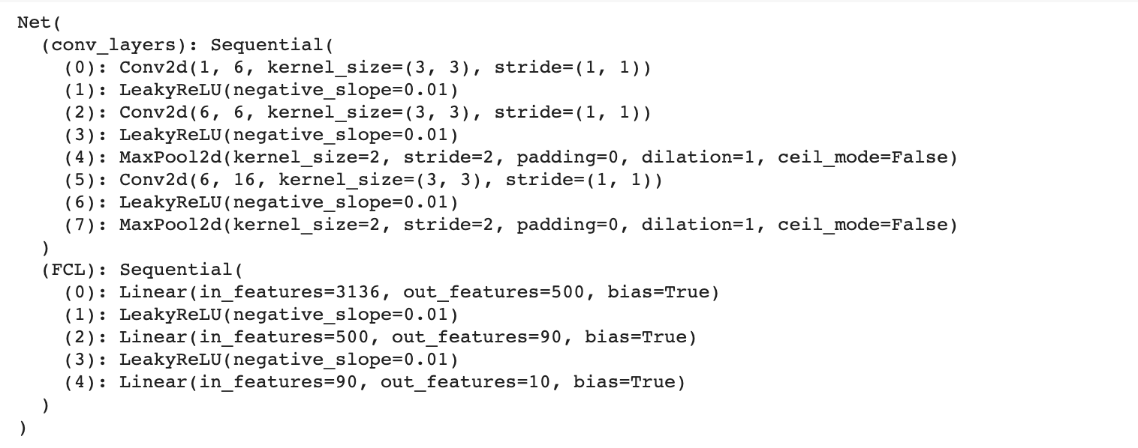
Model: LeNET
12

Slide 15
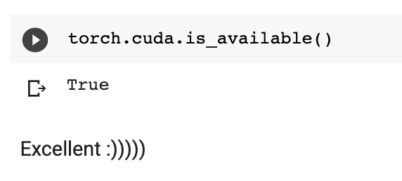
Training

Slide 16
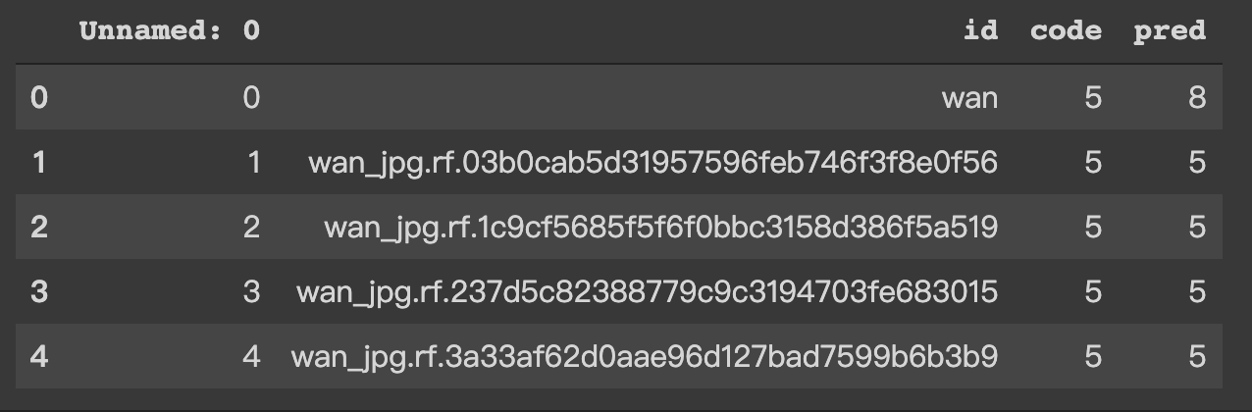
Training & Evaluation
13
Adam plus the learning rate of 0.00005.
We use a dataset with 39 pictures to test accuracy. It successfully recognized 35 of them(89%)

Slide 17
Future Improvements
Building a Chinese Car-plate Recognition System
15

Slide 18
Real-world Application
16
Works well under the scenario of parking lot
Replace the old-fashioned parking card
Already in large scale use in many parking places in Shanghai

Slide 19
Potential in video detection
17
Real-time capturing of the motion pictures
Frames are actually a continuous flow of images
Help the traffic police identify suspect vehicles more efficiently
Be part of the infrastructure of the “Internet +” idea active traffic management
Building the bridge between txt file (database entry) and the image

Slide 20


Special Thanks to:
18

Slide 21
References:
19
Youteek. “Modified LeNet-5: Chinese MNIST.” Kaggle, 23 Oct. 2020, www.kaggle.com/youteek/modified-lenet-5-chinese-mnist.
“TheAIGuysCode/Yolov4-Custom-Functions.” GitHub, 2020, github.com/theAIGuysCode/yolov4-custom-functions.
“License Plate Detection & Recognition Using Opencv & Pytesseract.” YouTube, uploaded by Techie Coder, 16 July 2020, www.youtube.com/watch?v=i_30im3FlCs&t=1112s.

